Slide 1
Unemployment
Pub 17 Chapter 12
(Federal 1040-line 19)
Notes:
1

Slide 2
Unemployment
Unemployment is taxable for Federal
Unemployment is not taxable in NJ
TW handles automatically
End-of-year tax statement:
1099-G Statement for Certain Government Payments
Notes:
2

Slide 3
NJ 1099-G for Unemployment
1099-G not mailed to taxpayer; must look up info on NJ Dept. of Labor website
Site is: http://lwd.state.nj.us/labor/ui/content/1099G.html
or
Link from TaxPrep4Free.org Preparer page: NJ Form 1099-G Inquiry (Unemployment)
Taxpayer must have a user name, password & pin to view/print 1099-G

Slide 4
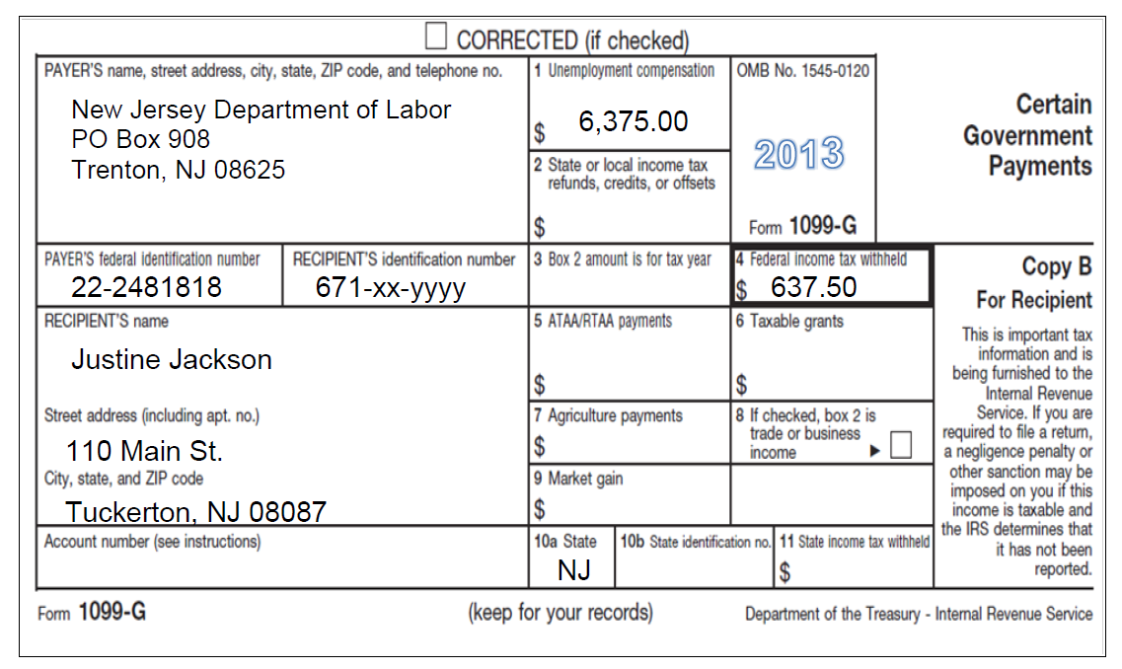
Sample 1099-G Unemployment Income
2014

Slide 5
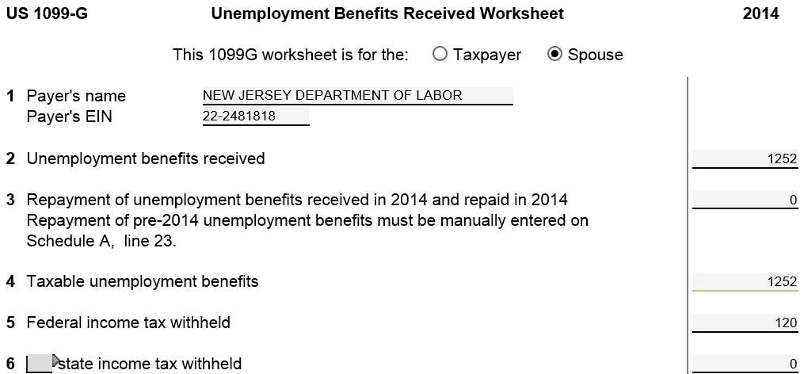
TW-Unemployment Benefits 1099-G
TW transfers to 1040 Line 19
TW includes in 1040 Line 64
Notes:
Pull up 1099-G Unemployment Benefits screen
Link from Line 19 on 1040 Page 1 (using arrow or F9) OR
Go directly to 1099-G by clicking on 1099G in Forms Tree
Check box to indicate if 1099-G is for taxpayer or spouse
Enter Payer’s Name & EIN from 1099-G
Enter data from 1099-G in appropriate boxes
NOTE: Unemployment benefits are taxable on Federal level, but not taxable in NJ. TW automatically handles this
5

Slide 6
TW Unemployment Benefits on 1040 Line 19
TW transfers from 1099-G
Notes:
TW transfers unemployment income from 1099-G screen to 1040 Line 19
6

